Slide 1




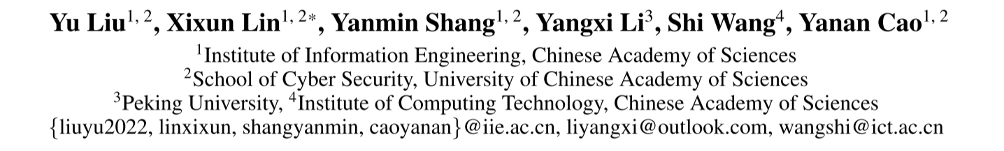





ATAI
Advanced Technique of Artificial Intelligence
ATAI
ChongqingUniversity _{AdvancedTechniqueof}
of Technology Artificial Intelligence
Chongqing University of
Technology
Chongqing University ^{ATAI}
_{of Technology} Advanced Techniqueof
Artificial Intelligence
Chongqing University of Technology
Chongqing University of Technology
PathMind: A Retrieve-Prioritize-Reason Framework for Knowledge Graph
Reasoning with Large Language Models
Code:https://github.com/liuyudiy/PathMind
——AAAI 2026
Reported by Xiang Zhang
1

Slide 2
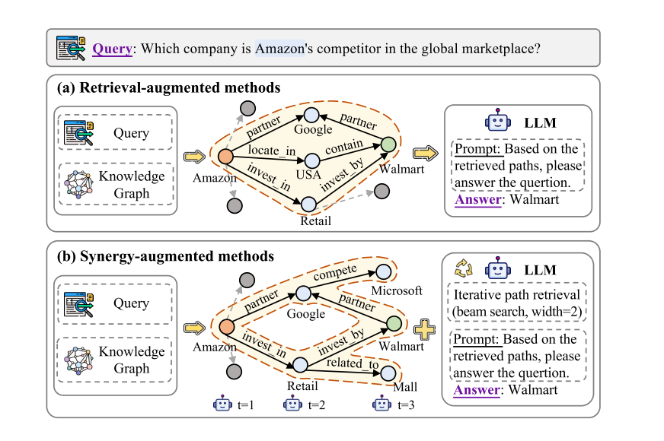
ATAI
Advanced Technique of Artificial Intelligence
ATAI
ChongqingUniversity _{AdvancedTechniqueof}
of Technology Artificial Intelligence
Chongqing University of
Technology
Chongqing University ^{ATAI}
_{of Technology} Advanced Techniqueof
Artificial Intelligence
Chongqing University of Technology
Chongqing University of Technology
Motivation
First,existing methods often extract reasoning paths indiscriminately, without assessing their different importance, which may introduce irrelevant noise that misleads LLMs.
Second, while some methods leverage LLMs to dynamically explore potential reasoning paths, they require high retrieval demands and frequent LLM calls.

Slide 3
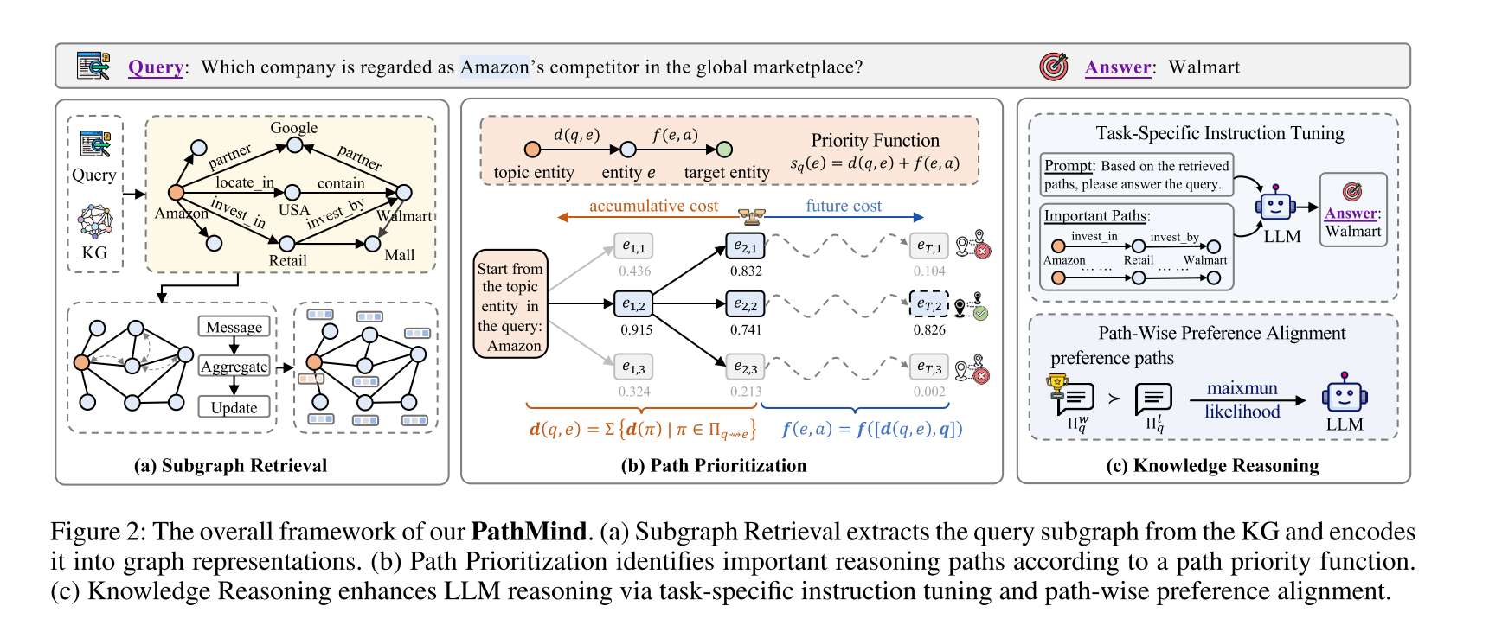
ATAI
Advanced Technique of Artificial Intelligence
ATAI
ChongqingUniversity _{AdvancedTechniqueof}
of Technology Artificial Intelligence
Chongqing University of
Technology
Chongqing University ^{ATAI}
_{of Technology} Advanced Techniqueof
Artificial Intelligence
Chongqing University of Technology
Chongqing University of Technology
Overview

Slide 4
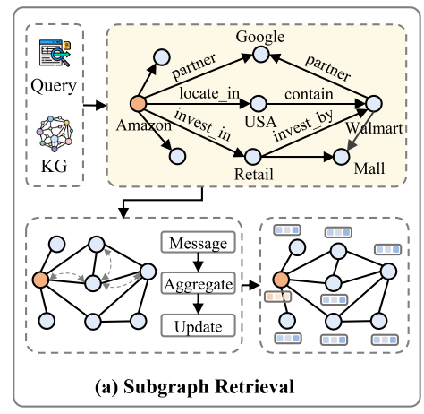
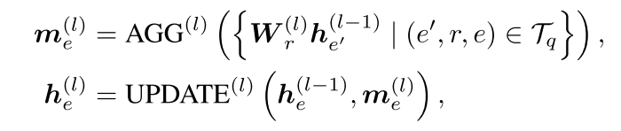
ATAI
Advanced Technique of Artificial Intelligence
ATAI
ChongqingUniversity _{AdvancedTechniqueof}
of Technology Artificial Intelligence
Chongqing University of
Technology
Chongqing University ^{ATAI}
_{of Technology} Advanced Techniqueof
Artificial Intelligence
Chongqing University of Technology
Chongqing University of Technology
Method

Slide 5
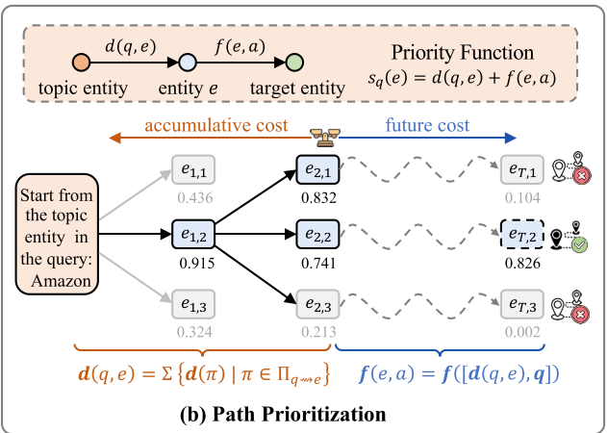
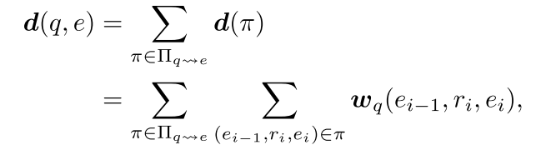
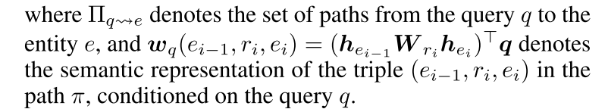


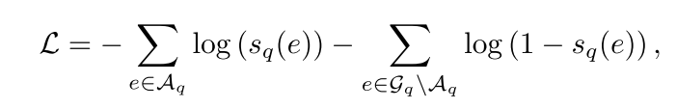
ATAI
Advanced Technique of Artificial Intelligence
ATAI
ChongqingUniversity _{AdvancedTechniqueof}
of Technology Artificial Intelligence
Chongqing University of
Technology
Chongqing University ^{ATAI}
_{of Technology} Advanced Techniqueof
Artificial Intelligence
Chongqing University of Technology
Chongqing University of Technology
Method

Slide 6
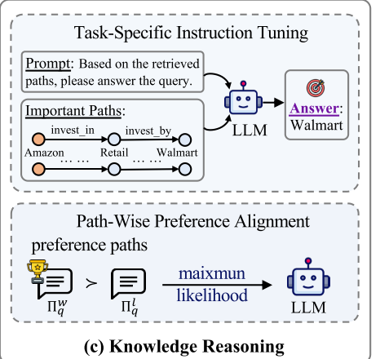
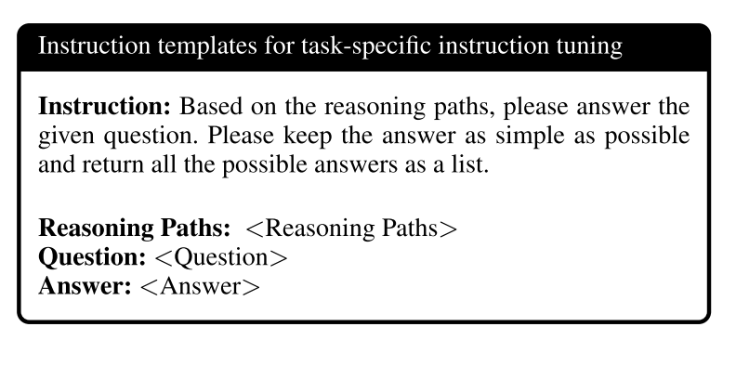

ATAI
Advanced Technique of Artificial Intelligence
ATAI
ChongqingUniversity _{AdvancedTechniqueof}
of Technology Artificial Intelligence
Chongqing University of
Technology
Chongqing University ^{ATAI}
_{of Technology} Advanced Techniqueof
Artificial Intelligence
Chongqing University of Technology
Chongqing University of Technology
Method

Slide 7
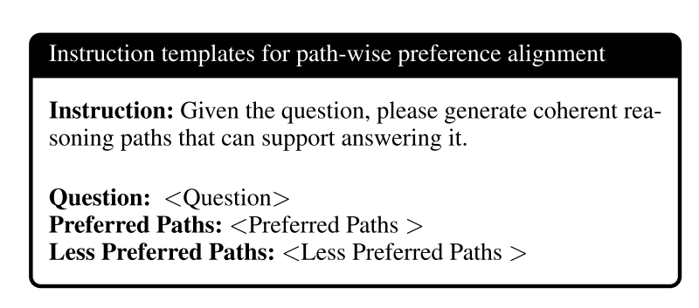
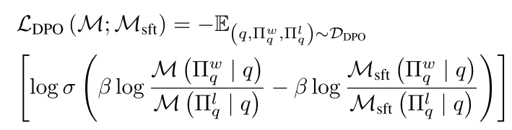
ATAI
Advanced Technique of Artificial Intelligence
ATAI
ChongqingUniversity _{AdvancedTechniqueof}
of Technology Artificial Intelligence
Chongqing University of
Technology
Chongqing University ^{ATAI}
_{of Technology} Advanced Techniqueof
Artificial Intelligence
Chongqing University of Technology
Chongqing University of Technology
Method

Slide 8
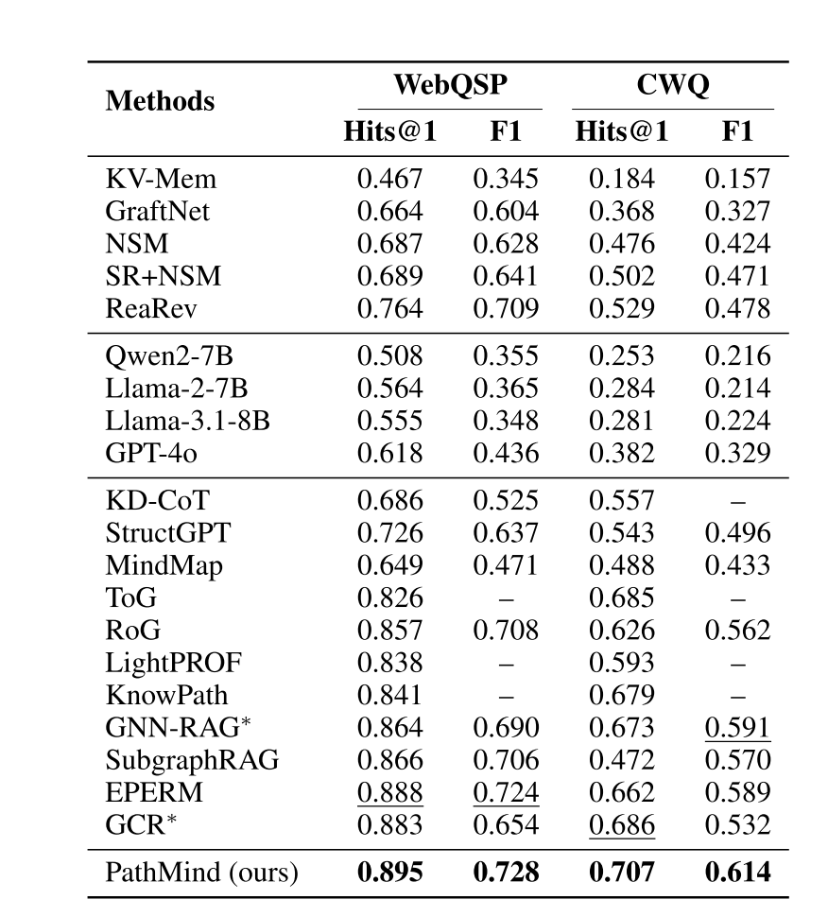
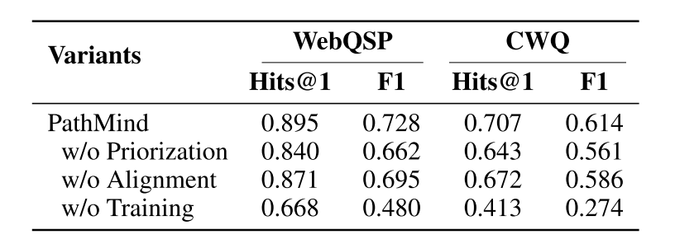
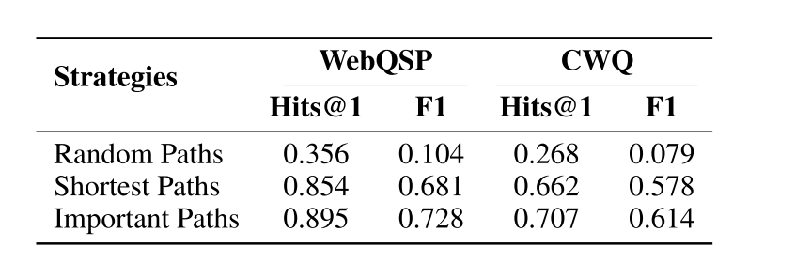
ATAI
Advanced Technique of Artificial Intelligence
ATAI
ChongqingUniversity _{AdvancedTechniqueof}
of Technology Artificial Intelligence
Chongqing University of
Technology
Chongqing University ^{ATAI}
_{of Technology} Advanced Techniqueof
Artificial Intelligence
Chongqing University of Technology
Chongqing University of Technology
Experiments

Slide 9
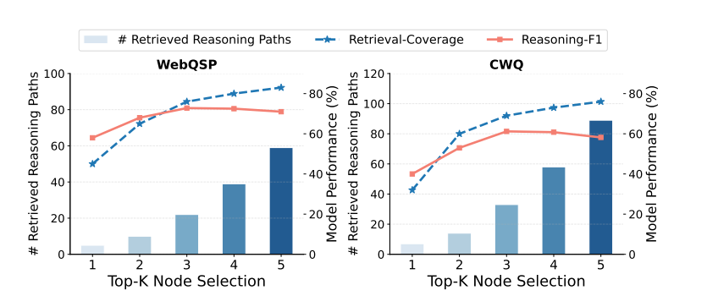
ATAI
Advanced Technique of Artificial Intelligence
ATAI
ChongqingUniversity _{AdvancedTechniqueof}
of Technology Artificial Intelligence
Chongqing University of
Technology
Chongqing University ^{ATAI}
_{of Technology} Advanced Techniqueof
Artificial Intelligence
Chongqing University of Technology
Chongqing University of Technology
Experiments

Slide 10
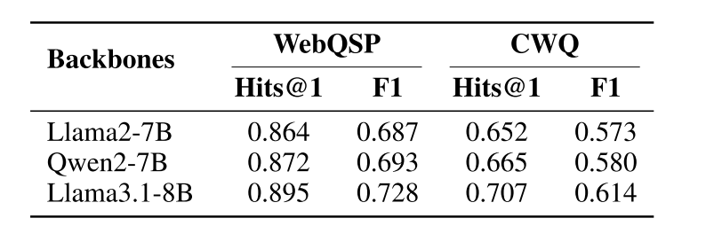
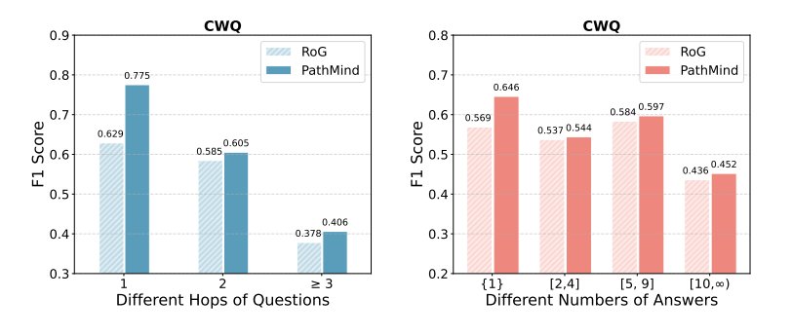
ATAI
Advanced Technique of Artificial Intelligence
ATAI
ChongqingUniversity _{AdvancedTechniqueof}
of Technology Artificial Intelligence
Chongqing University of
Technology
Chongqing University ^{ATAI}
_{of Technology} Advanced Techniqueof
Artificial Intelligence
Chongqing University of Technology
Chongqing University of Technology
Experiments

Slide 11
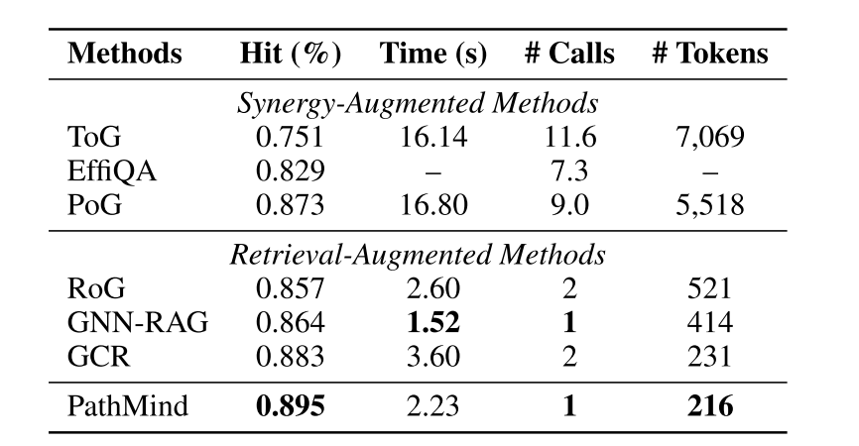
ATAI
Advanced Technique of Artificial Intelligence
ATAI
ChongqingUniversity _{AdvancedTechniqueof}
of Technology Artificial Intelligence
Chongqing University of
Technology
Chongqing University ^{ATAI}
_{of Technology} Advanced Techniqueof
Artificial Intelligence
Chongqing University of Technology
Chongqing University of Technology
Experiments

Slide 12


ATAI
Advanced Technique of Artificial Intelligence
ATAI
ChongqingUniversity _{AdvancedTechniqueof}
of Technology Artificial Intelligence
Chongqing University of
Technology
Chongqing University ^{ATAI}
_{of Technology} Advanced Techniqueof
Artificial Intelligence
Chongqing University of Technology
Chongqing University of Technology
Thanks!

